Slide 1
Hand massage for everyone
1. Using the thumb of your right hand, apply pressure as you trace the lines from your left wrist up your palm, moving an imaginary space left each time. Repeat this three times.
2. Rub each finger of your left hand between the thumb and the first finger of your right hand, from the bottom of the finger up to the tip.

Slide 2
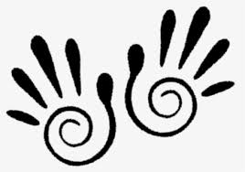
3. Now pull gently between each finger web space. These are the reflex points for the Lymphatic glands and so these movements stimulate the immune system as well as relax your fingers and hands.
Remember to breath, slow and deep, relaxing into the massage. Use gentle pressure and really feel your hands, your skin and the muscle within.

Slide 3
4.Press into the triangular web space between your first finger and thumb. This is the Acupoint LI-4, and is great for easing headaches and enhancing a general feeling of wellbeing.
5.Now gently massage the heal of your hand with your thumb. This is a reflex point to release stress and tension in the back, use gentle pressure and time in this area.
Remember take some time, there’s no rush, breath and relax.
Repeat the whole process on your right hand.

